Slide 1


Department of Computer Science and Engineering
CS19811 – Project Phase-II
AUTOMATIC SEGMENTATION & CLASSIFICATION OF CT LIVER TUMOR IMAGES USING CNN MODEL
Dr.B.VIJAYALAKSHMI
SUBRAHMANYAN D 200701312
JOBIN JOHN ABRAHAM 200701506

Slide 2
Problem Statement and Motivation
Liver tumor segmentation from medical images is crucial for cancer diagnosis and treatment planning. The complexities of liver anatomy and diverse tumor appearances make manual methods challenging. Existing automated techniques struggle due to intensity overlaps and tissue variations. This research aims to develop deep learning methods for accurate liver tumor segmentation. This project addresses challenges to enhance patient care and treatment outcomes. Liver cancer's global impact motivates this work. Automated segmentation can save time for radiologists, improving patient care. By utilizing deep learning, the goal is to overcome segmentation limitations and use robust algorithms for accurate tumor delineation. This advancement could revolutionize treatment planning and improve patient prognosis.

Slide 3
Objectives
To develop a model to pinpoint liver tumours in medical images with accurate location details.
Achieve detailed segmentation for outlining liver tumour boundaries to improve treatment strategies.
Enhance the model to differentiate various stages of liver tumour, through segmentation.

Slide 4
Abstract
The segmentation of liver tumors in medical imaging is a critical task with significant implications for diagnosis, treatment planning, and patient care. This project presents a comprehensive study on liver tumor segmentation techniques, aiming to enhance the accuracy and efficiency of this crucial process. The project begins by curating a diverse dataset of medical images containing liver tumors, ensuring representation of various tumor types, sizes, and locations. Manual annotations are meticulously generated to provide ground truth segmentation masks for the tumors. This project is proposed to use Deep learning methods such as Convolutional Neural Networks (CNNs) where the TransUNet is used. These methods will be implemented and systematically evaluated using established metrics like precision, and recall. The findings suggest that deep learning models have the potential to revolutionize the way liver tumors are segmented, enhancing diagnostic capabilities and contributing to improved patient care.

Slide 5
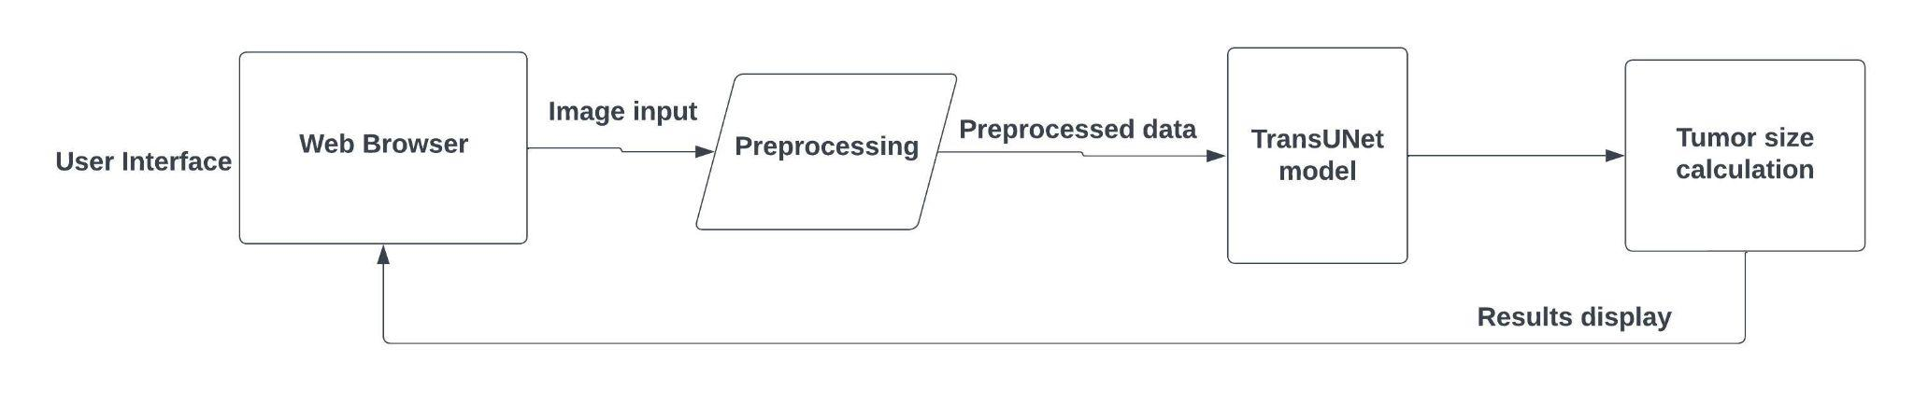
System Architecture
.

Slide 6
List of Modules
Preprocessing
TransUNet Model segmentation
Tumor segmentation and stage display

Slide 7
Preprocessing
The preprocessing part is started. The noise and the unwanted excess region around the liver is segmented further processing is done.
Preprocessing is a vital stage where it involves various processes such as data augmentation, noise reduction, scaling, rotation etc and reduces the work for the model and helps in improving the performance of the model.

Slide 8
TransUNet Model Segmentation
Once the images are preprocessed and is suitable for training the datasets stored in the database are used for model training and train the model to differentiate between tumors and non tumor regions in order to support an effective segmentation. Nearly 70% of the dataset will be utilized in training the model and focuses on effective training. This helps in identifying the tumor much as possible. Furthermore enhancement and deductions will be carried out while segmenting the tumors and more details will be inferred.

Slide 9
Tumor Segmentation & Stage Display
Once the model completes the evaluation and classification,the images are being segmented, the size of the segmented tumor will be calculated based on segmented tumors.
After the results are obtained, the respective metrics and all the obtained results will be displayed to the User Interface and the images and the classification plays a vital role in the segmentation part. According to the the size of tumor obtained, the respective stage of the tumor will be displayed for the given input.

Slide 10
CNN
The convolution operation involves combining input data (feature map) with a convolution kernel (filter) to form a transformed feature map. The filters in the convolutional layers (conv layers) are modified based on learned parameters to extract the most useful information for a specific task. Convolutional networks adjust automatically to find the best feature based on the task. The CNN would filter information about the shape of an object when confronted with a general object recognition task but would extract the color of the bird when faced with a bird recognition task.

Slide 11
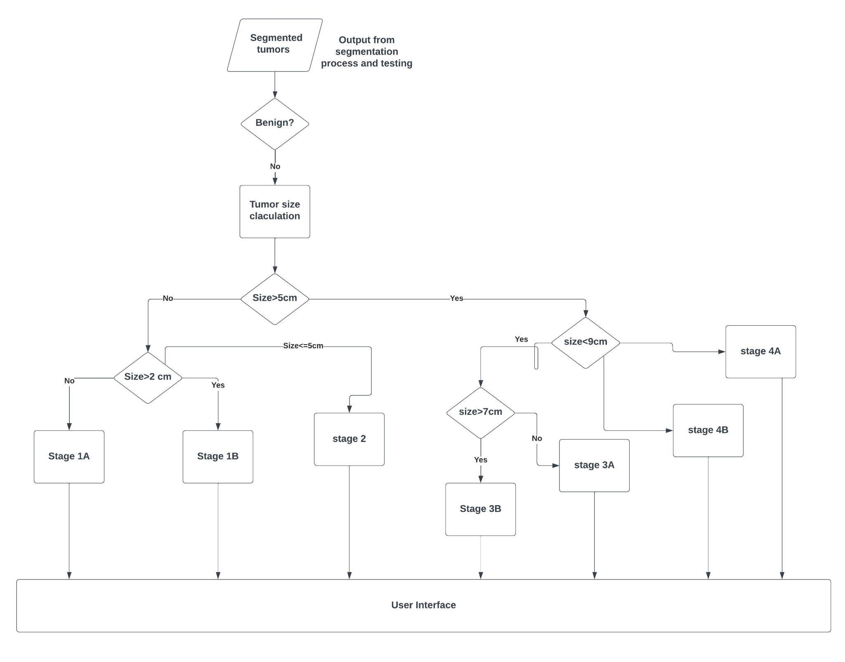
Activity Diagram

Slide 12
Implementation/Results of Module
.

Slide 13
Pending Modules & Conclusion
Login Module

Slide 14
References
Zhang, X., Xie, F., Shinagawa, Y., & Tajahuerce, E. (2021). Liver tumor segmentation from contrast-enhanced CT images using cascaded fully convolutional neural networks and attention mechanisms. Computers in Biology and Medicine, 129, 104131.
Wang, T., Yang, Q., & Liu, Z. (2020). A deep learning-based framework for liver tumor segmentation using multiple MRI sequences. Medical physics, 47(5), 2188-2199
Li, Q., Dou, Q., Chen, H., Qin, J., & Heng, P. A. (2018). Automatic liver tumor segmentation using a fully convolutional neural network (FCN) enhanced with residual connections. IEEE Transactions on Medical Imaging, 35(5), 1245-1254.
Christ, P. F., Elshaer, M. E., Ettlinger, F., Tatavarty, S., Bickel, M., Bilic, P., ... & Rempfler, M. (2016). Automatic liver and lesion segmentation in CT using cascaded fully convolutional neural networks and 3D conditional random fields. In International Conference on Medical Image Computing and Computer-Assisted Intervention (pp. 415-423). Springer, Cham.

Slide 15
References
A. P R and L. T M, "Automatic segmentation and classification of the liver tumor using deep learning algorithms," 2023 3rd International Conference on Advances in Computing, Communication, Embedded and Secure Systems (ACCESS), Kalady, Ernakulam, India, 2023, pp. 334-339, doi: 10.1109/ACCESS57397.2023.10200900.
A. R and A. L, "Effective Methods to Detect Liver Cancer Using CNN and Deep Learning Algorithms," 2023 International Conference on Advances in Computing, Communication and Applied Informatics (ACCAI), Chennai, India, 2023, pp. 1-7, doi: 10.1109/ACCAI58221.2023.10200341.
L. Krishnakumari, R. Ramalakshmi, V. Srirenganachiyar, K. Ragavan and K. Ramalakshmi, "Analysis of Liver Tumor Segmentation using Deep ResUNet," 2023 Third International Conference on Artificial Intelligence and Smart Energy (ICAIS), Coimbatore, India, 2023, pp. 665-668, doi: 10.1109/ICAIS56108.2023.10073676.
A. M. and M. P., "Liver Tumor Segmentation and Classification Using Deep Learning," 2023 Fifth International Conference on Electrical, Computer and Communication Technologies (ICECCT), Erode, India, 2023, pp. 01-07, doi: 10.1109/ICECCT56650.2023.10179731.

Slide 16
References
A. Patel, K. Prateek and S. Maity, "A W-Net Based Architecture with Residual Block for Liver Segmentation," 2022 4th International Conference on Inventive Research in Computing Applications (ICIRCA), Coimbatore, India, 2022, pp. 1783-1788, doi: 10.1109/ICIRCA54612.2022.9985767.
Z. Naaqvi, S. Akbar, S. A. Hassan and Q. Ul Ain, "Detection of Liver Cancer through Computed Tomography Images using Deep Convolutional Neural Networks," 2022 2nd International Conference on Digital Futures and Transformative Technologies (ICoDT2), Rawalpindi, Pakistan, 2022, pp. 1-6, doi: 10.1109/ICoDT255437.2022.9787429.
V. Gavini and G. R. J. Lakshmi, "Liver Tumor Grade Detection using CNN Based LSTM Model with Corelated Feature Set from CT Images," 2022 International Conference on Automation, Computing and Renewable Systems (ICACRS), Pudukkottai, India, 2022, pp. 843-850, doi: 10.1109/ICACRS55517.2022.10029307.
L. Hong, R. Wang, T. Lei, X. Du and Y. Wan, "Qau-Net: Quartet Attention U-Net for Liver and Liver-Tumor Segmentation," 2021 IEEE International Conference on Multimedia and Expo (ICME), Shenzhen, China, 2021, pp. 1-6, doi: 10.1109/ICME51207.2021.9428427.

Slide 17
References
Z. Khan and R. Loganathan, "AutoLiv: Automated Liver Tumor Segmentation in CT Images," 2020 International Conference on Smart Technologies in Computing, Electrical and Electronics (ICSTCEE), Bengaluru, India, 2020, pp. 151-156, doi: 10.1109/ICSTCEE49637.2020.9277076.
M. Rela, N. R. Suryakari and P. R. Reddy, "Liver Tumor Segmentation and Classification: A Systematic Review," 2020 IEEE-HYDCON, Hyderabad, India, 2020, pp. 1-6, doi: 10.1109/HYDCON48903.2020.9242757.
S. -T. Tran, C. -H. Cheng and D. -G. Liu, "A Multiple Layer U-Net, Un-Net, for Liver and Liver Tumor Segmentation in CT," in IEEE Access, vol. 9, pp. 3752-3764, 2021, doi: 10.1109/ACCESS.2020.3047861.
X. Dong, Y. Zhou, L. Wang, J. Peng, Y. Lou and Y. Fan, "Liver Cancer Detection Using Hybridized Fully Convolutional Neural Network Based on Deep Learning Framework," in IEEE Access, vol. 8, pp. 129889-129898, 2020, doi: 10.1109/ACCESS.2020.3006362.

Slide 18
References
X. Li, H. Chen, X. Qi, Q. Dou, C. -W. Fu and P. -A. Heng, "H-DenseUNet: Hybrid Densely Connected UNet for Liver and Tumor Segmentation From CT Volumes," in IEEE Transactions on Medical Imaging, vol. 37, no. 12, pp. 2663-2674, Dec. 2018, doi: 10.1109/TMI.2018.2845918.
M. Sato, Z. Jin and K. Suzuki, "Semantic Segmentation of Liver Tumor in Contrast-enhanced Hepatic CT by Using Deep Learning with Hessian-based Enhancer with Small Training Dataset Size," 2021 IEEE 18th International Symposium on Biomedical Imaging (ISBI), Nice, France, 2021, pp. 34-37, doi: 10.1109/ISBI48211.2021.9433929.
Y. Li et al., "Sketch-supervised Histopathology Tumour Segmentation: Dual CNN-Transformer with Global Normalised CAM," in IEEE Journal of Biomedical and Health Informatics, doi: 10.1109/JBHI.2023.3289984.
Amritha. M, Manimegalai. P “Liver Tumor Segmentation and Classification Using Deep Learning” 2023 Fifth International Conference on Electrical, Computer and Communication Technologies (ICECCT)

Slide 19
References
A. R and A. L, ”Effective Methods to Detect Liver Cancer Using CNN and Deep Learning Algorithms,” 2023 International Conference on Advances in Computing, Communication and Applied Informatics (ACCAI), Chennai, India, 2023, pp. 1-7, doi: 10.1109/ACCAI58221.2023.10200341.
Krishnakumari, L., Ramalakshmi, R., Srirenganachiyar, V., Ragavan,K., & Ramalakshmi, K. (2023). Analysis of Liver Tumor Segmentation using Deep ResUNet. 2023 Third International Conference on Artificial Intelligence and Smart Energy (ICAIS), 665-668.
A. M. and M. P., ”Liver Tumor Segmentation and Classification Using Deep Learning,” 2023 Fifth International Conference on Electrical, Computer and Communication Technologies (ICECCT), Erode, India, 2023, pp. 01-07, doi: 10.1109/ICECCT56650.2023.10179731.

Slide 20
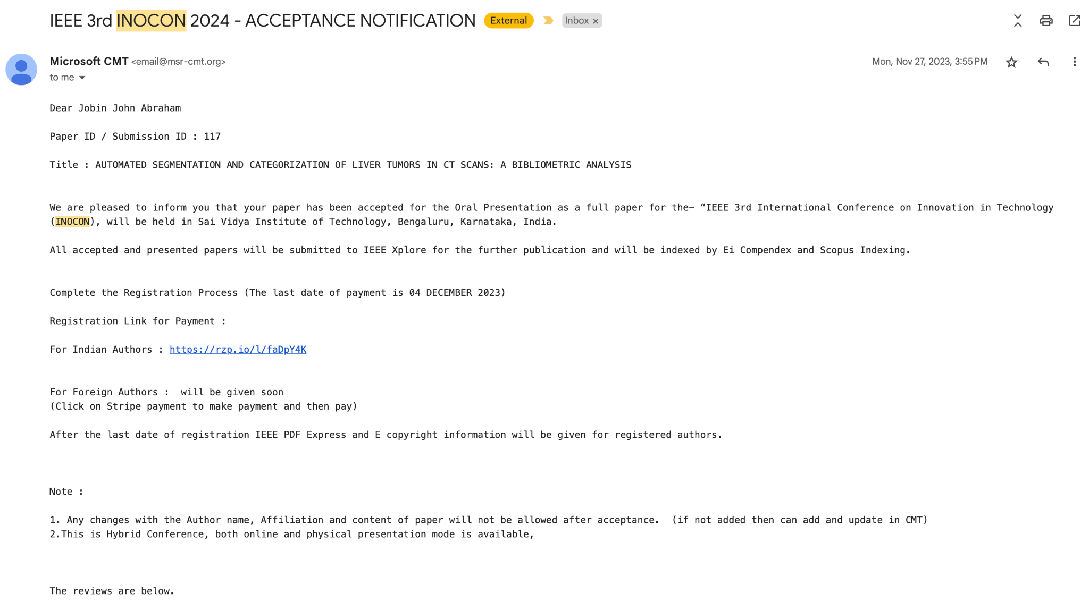
Paper Publication Status (Phase-I)

Slide 21
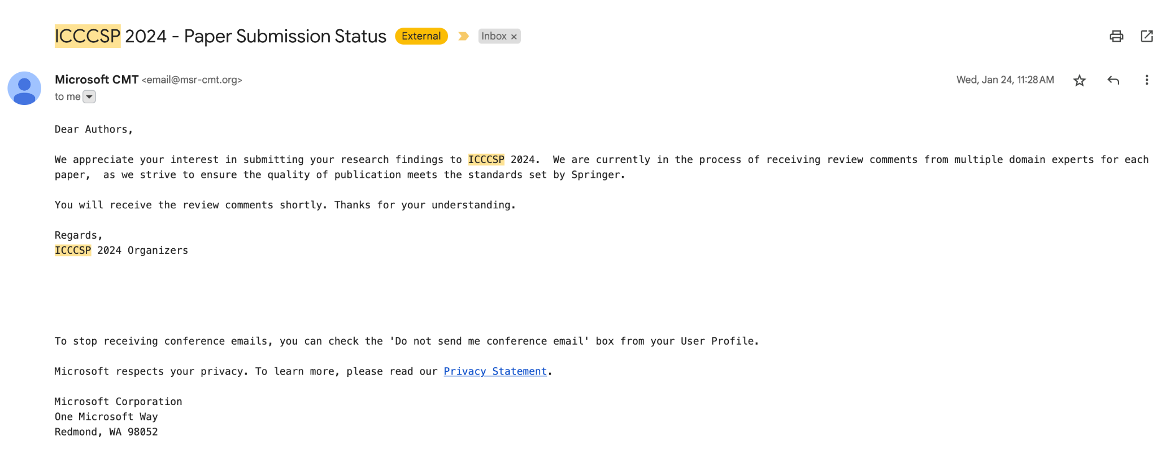
Paper Publication Status (Phase-II)

Slide 22
Thank You

